Slide 1
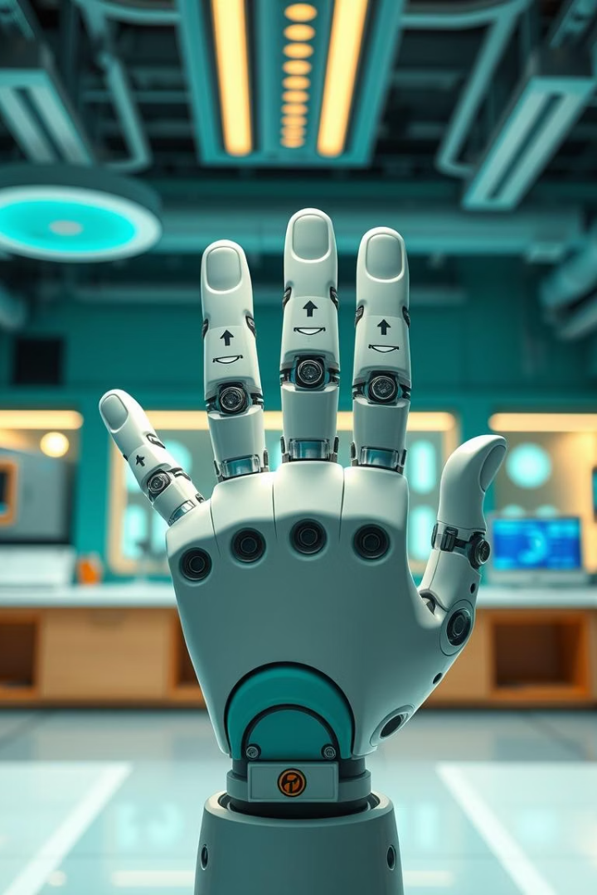
Gesture Genie: ASL to Speech Conversion
Gesture Genie: Sign to Speech Translator is an assistive technology project designed to bridge the communication gap between the deaf/mute community and the hearing population. The system leverages computer vision and deep learning techniques to recognize American Sign Language (ASL) gestures and convert them into real-time speech output. The system recognizes static hand signs representing alphabets and converts them into spoken words through a simple and user-friendly desktop interface. The solution provides high accuracy, swift response time, and practical usability for real-world scenarios.

Slide 2





Introduction
Communication Barriers
Deaf and mute individuals face significant communication challenges.
Sign Language Importance
Sign language is vital for expression, but not universally understood.
Real-time Translation Need
Real-time ASL to speech translation is crucial.
Project Goal
Our project aims to bridge this communication gap using AI.

Slide 3
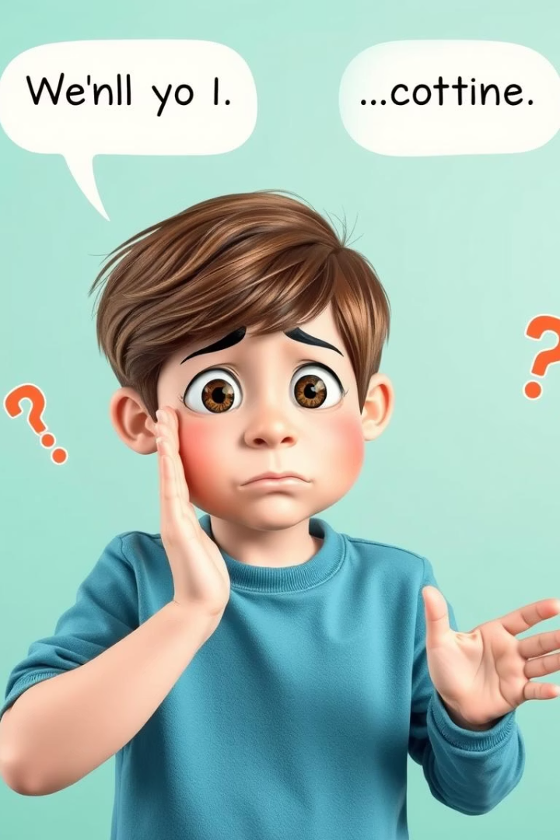



Problem Statement
ASL Understanding
Interpreter Limitations
Limited understanding of ASL among the general population.
Human interpreters are costly and not always available.
Tech Solutions
Need for affordable, real-time, and scalable technology.

Slide 4

Project Objectives
Gesture Recognition
Achieve real-time ASL gesture recognition.
Speech Conversion
Convert recognized signs directly into spoken words.
Web-based UI
Develop an intuitive web-based user interface.
Accessibility & Expandability
Ensure wide accessibility and future expandability.

Slide 5
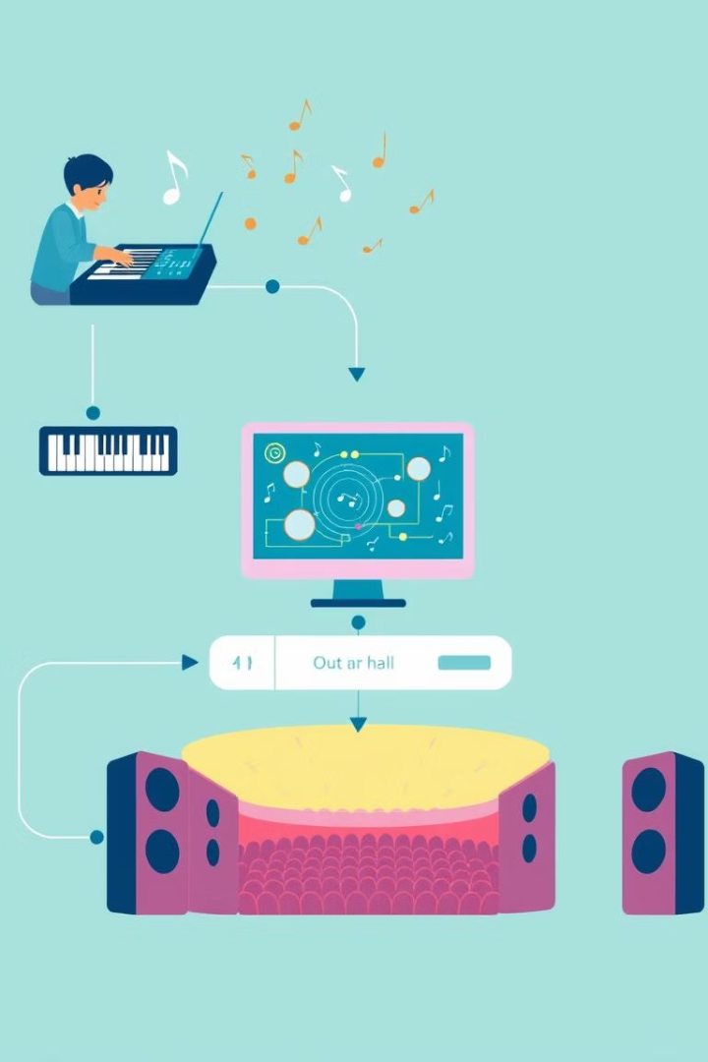
Methodology Overview
1
Input
Live video feed of hand gestures.
2
Processing
Hand landmark detection, gesture classification performed using MobileNet
3
Output
Spoken words generated via Text-to-Speech (TTS).
4
Tools
Python, OpenCV, TensorFlow, Teachable Machine, Flask.

Slide 6








System Design
Data Collection
Model Training
Gather and preprocess gesture data for training.
Train AI models using CNN Architecture (MobileNet).
User Interface
Real-time Prediction
Provide a UI with live webcam feed for interaction.
Perform live gesture prediction and speech generation.

Slide 7




Model Training
Accuracy
1
Achieved over 95% accuracy for static ASL letters.
Model
2
Utilized transfer learning with MobileNet and Dense layers.
Preprocessing
3
Input data was preprocessed through resizing and normalization.
Input Data
4
Trained with ASL static alphabet gestures.

Slide 8
Real-Time Prediction Interface
Framework
Features
Built using Flask and JavaScript for seamless interaction.
Live webcam feed for gesture input.
Predicts letters with confidence scores.
Buttons for "Add", "Space", "Clear", "Speak", "Quit".

Slide 9
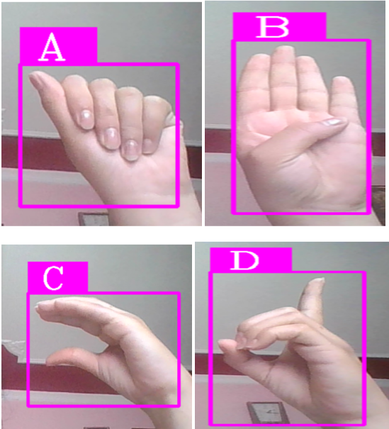
Results and Evaluation
95%+
<100ms
Accuracy
Response Time
High classification accuracy in varied conditions.
Fast response time for real-time interaction.
0
GPU Usage
Smooth performance without requiring a GPU.

Slide 10

Conclusion & Future Scope
Social Impact
Deployment & Dynamic Gestures
Enables greater inclusivity and independence for users.
NLP Integration
Effective Communication
Future enhancements include NLP for phrase prediction.
Plan for mobile/web deployment and dynamic gesture recognition.
Gesture Genie serves as an effective tool for ASL users.

